Slide 1
Static Website with S3, Lifecycle Management, and DynamoDB
GUIDED BY: MOHAMMAD SAYUDDIN
MENTOR: ANUSUYA
17-03-2025

Slide 2
PROBLEM STATEMENT
Challenge: Establishing a secure, version-controlled static website in a digital landscape where effective online presence is crucial.
Key Issues
Content Management: Difficulty in managing updates and rolling back to previous versions without systematic version control.
Security Vulnerabilities: Risk of unauthorized access and attacks, leading to potential data breaches.
Cost-Effectiveness: Need for solutions that balance reliable performance with operational costs.
Performance and Scalability: Ensuring the website can handle increased traffic efficiently.

Slide 3
PROJECT OVERVIEW
OBJECTIVE:Create a cost-optimized,secure Static Wesite with lifecycle management and replication
KEY COMPONENTS: S3, DynamoDB, CloudFront, AWS Lambda, AWS WAF
Outcome: A roust website architecture with full version control and disaster recovery

Slide 4
ARCHITECTURE DIAGRAM
S3 BUCKET(HOSTED WEBSITE)
CLOUD FRONT DISTRIBUTION(CACHING AND CDN)
DYNAMODB(META STORAGE)
LAMBDA(AUTOMATING UPDATES)
AWS WAF(SECURITY)
LIFECYCLE MANAGEMENT CONFIGURATION

Slide 5
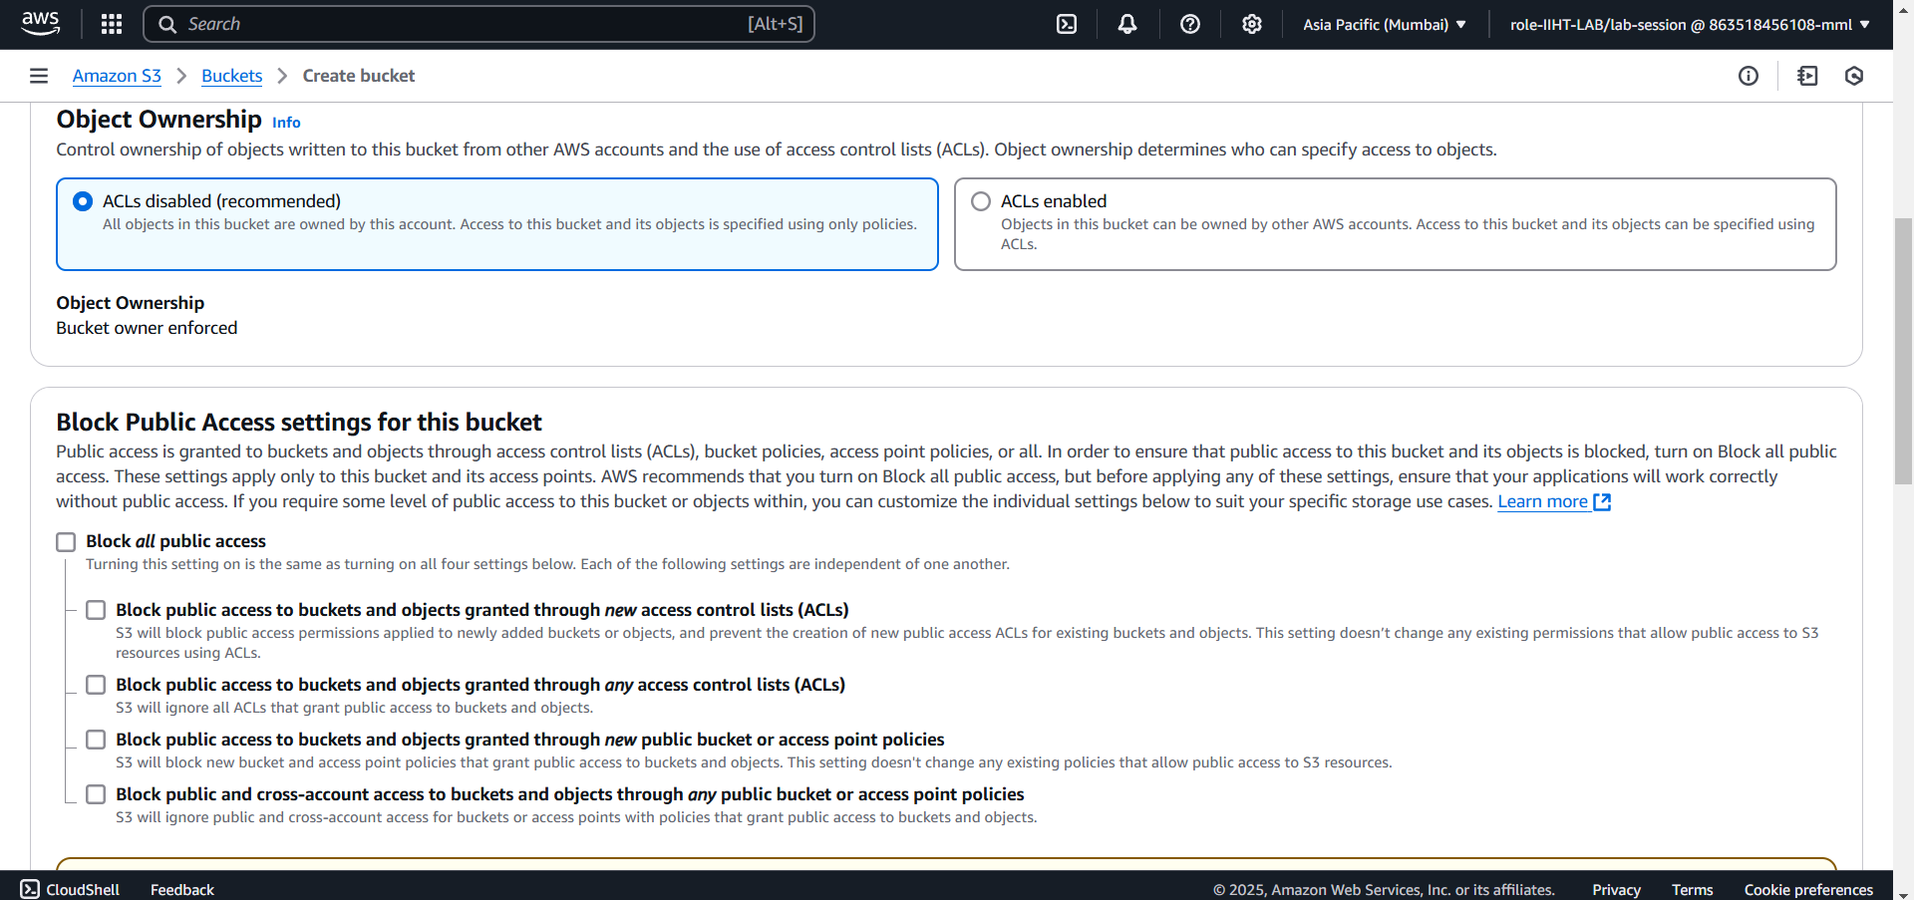
Creating a s3 bucket

Slide 6
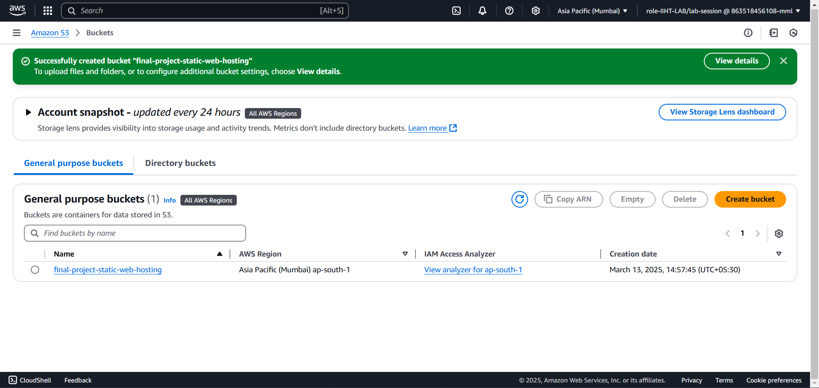
Created AN Empty Bucket

Slide 7
Creating a bucket policy

Slide 8
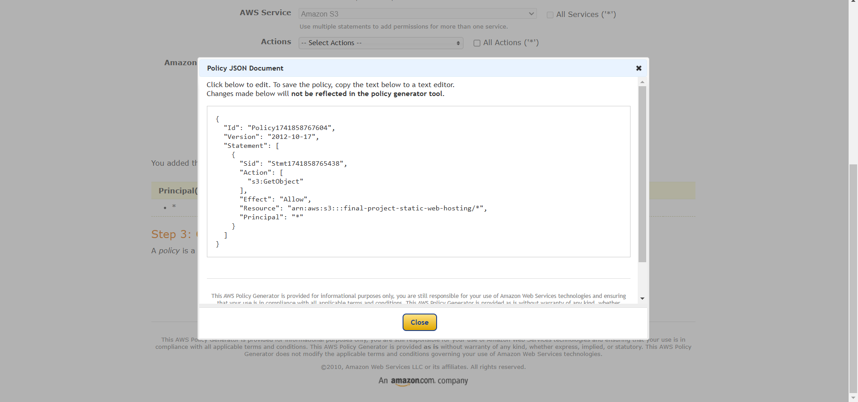
generating a bucket policy

Slide 9
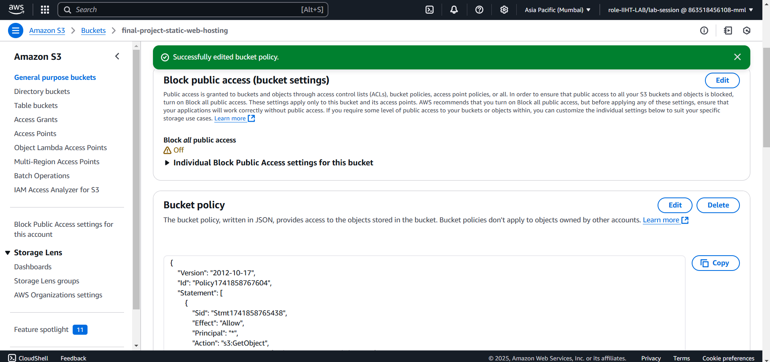
Adding Bucket policy

Slide 10
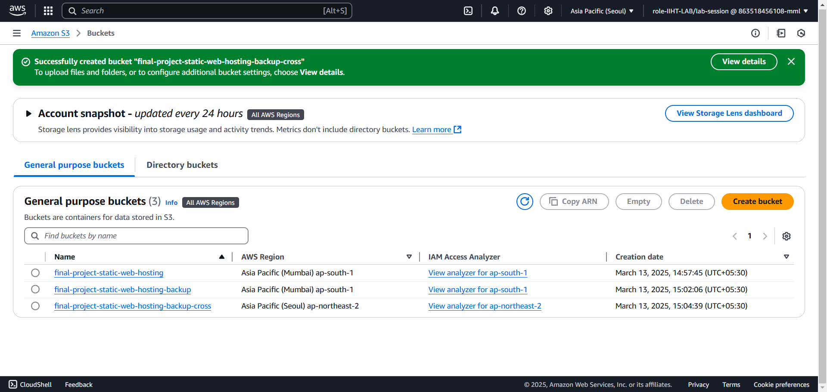
S3 backup and cross region replication

Slide 11
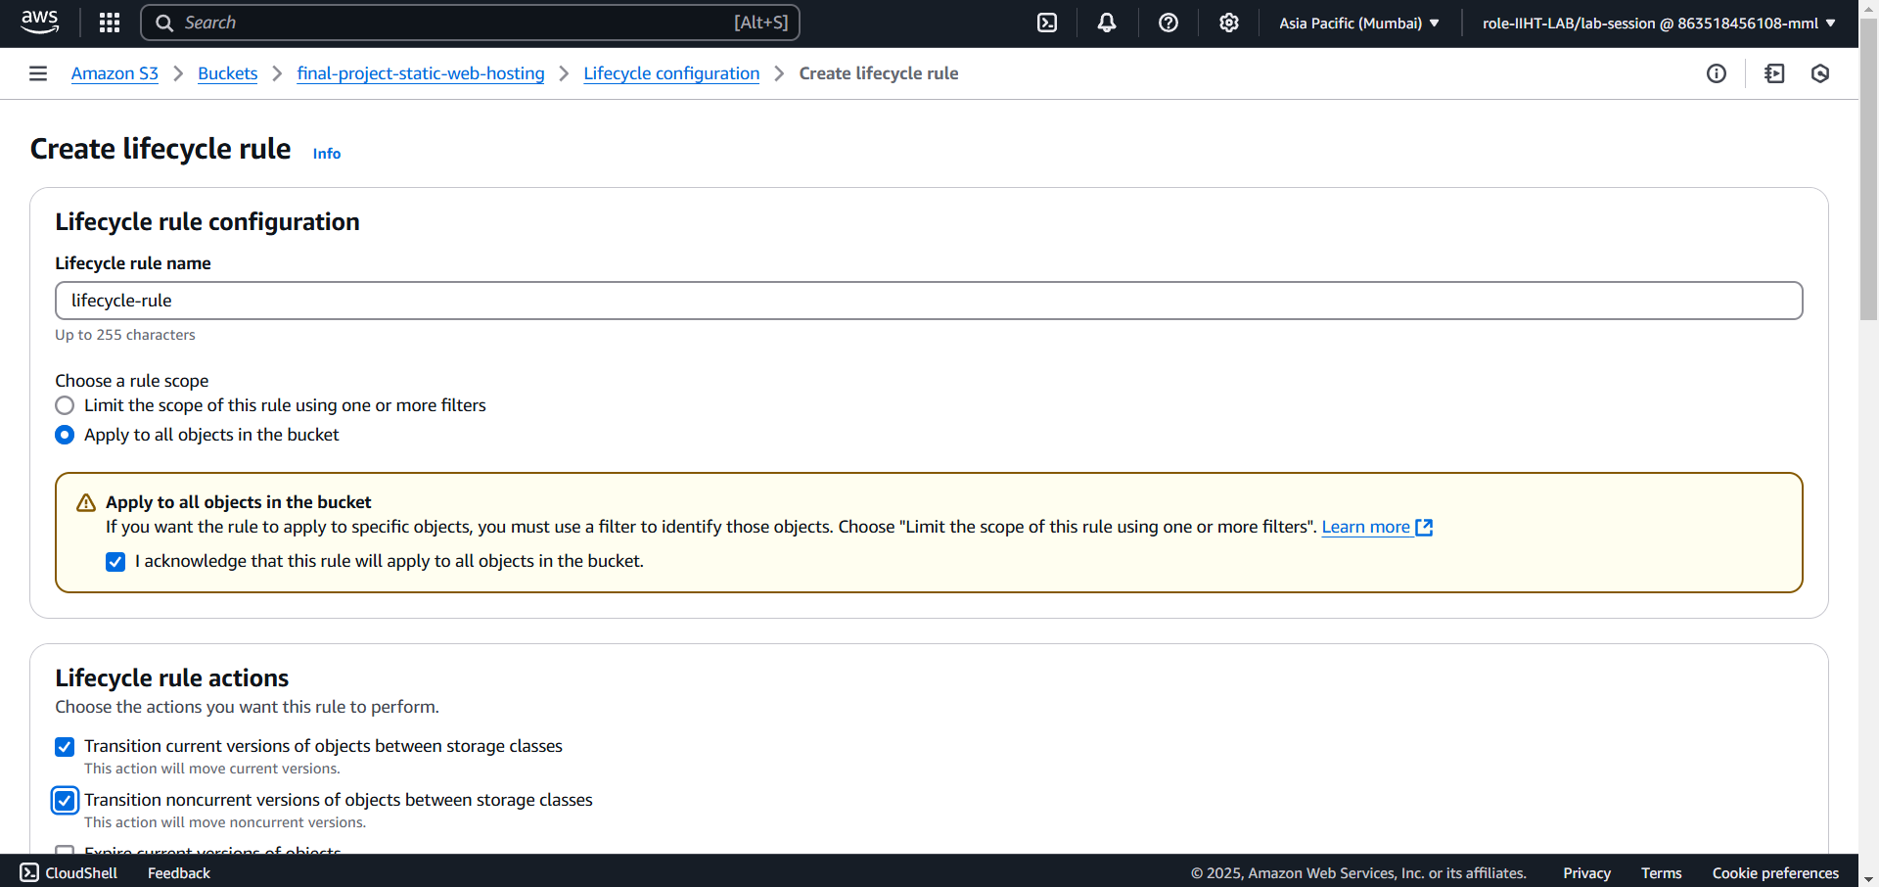
Create a lifecycle rule

Slide 12
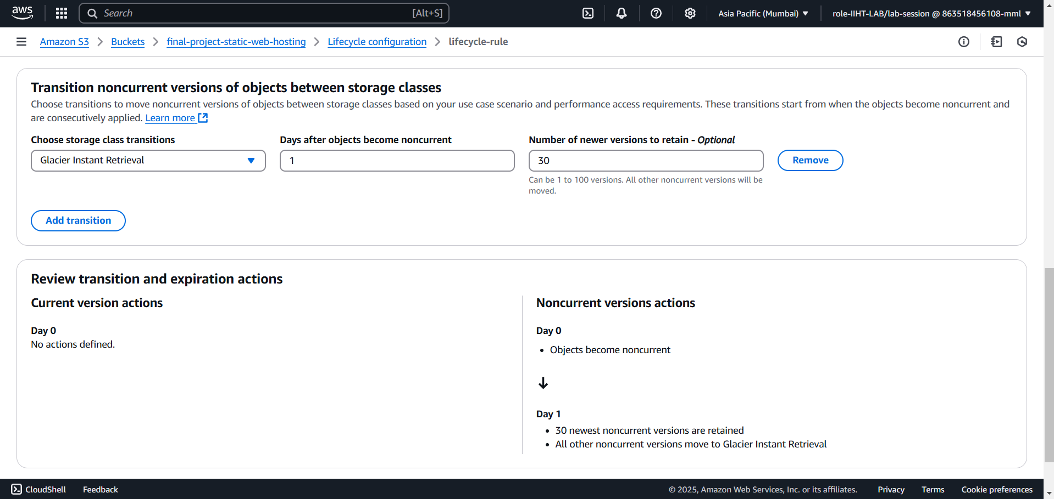

Slide 13
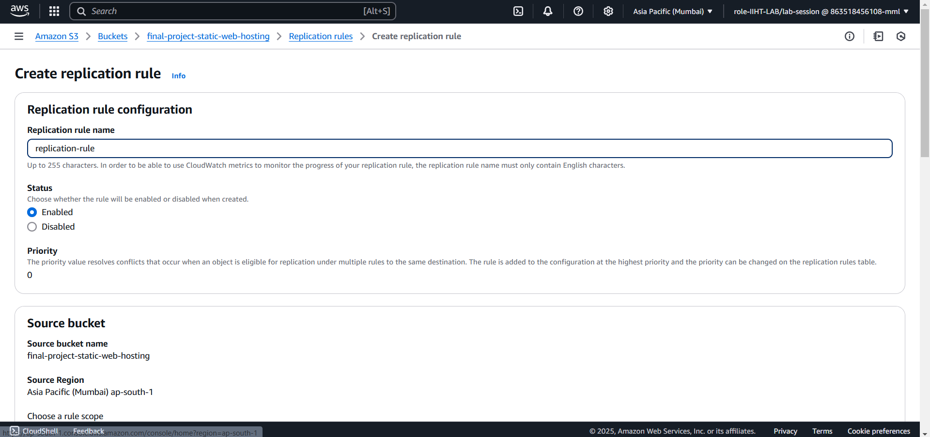
Replication rule (backup)

Slide 14
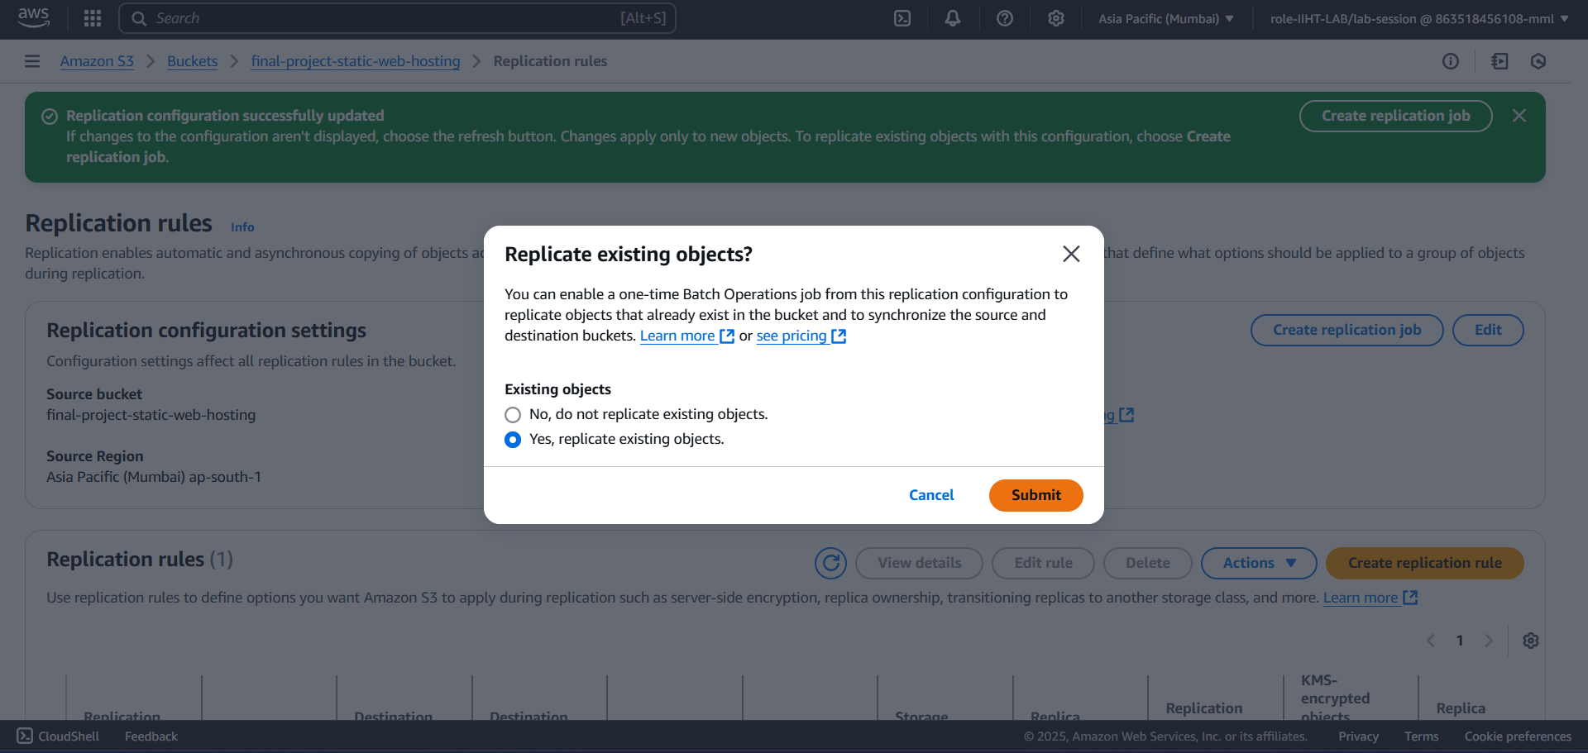
Replicating Existing objects

Slide 15
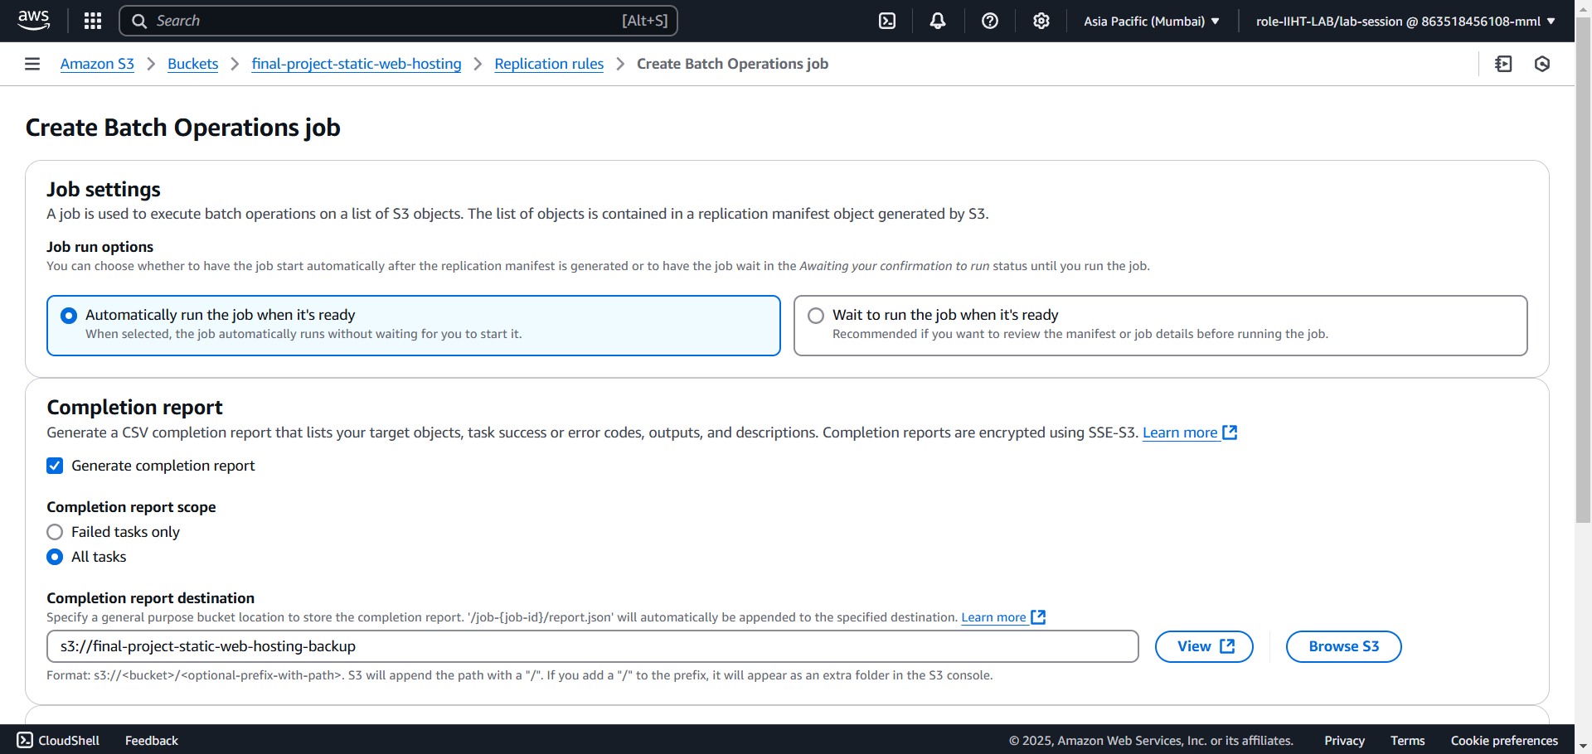
Batch operation job

Slide 16
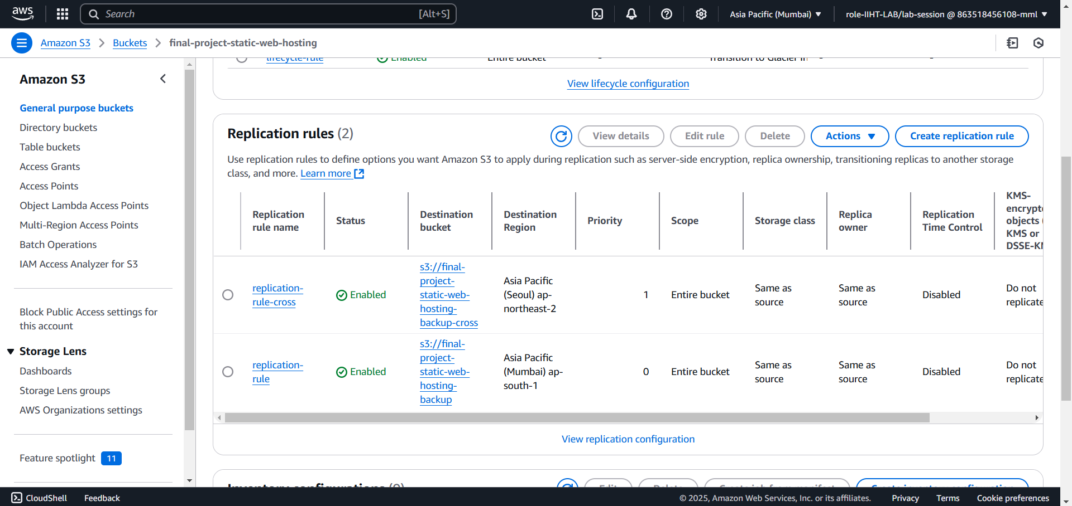
Cross region replication

Slide 17
Create a dynamodb table

Slide 18
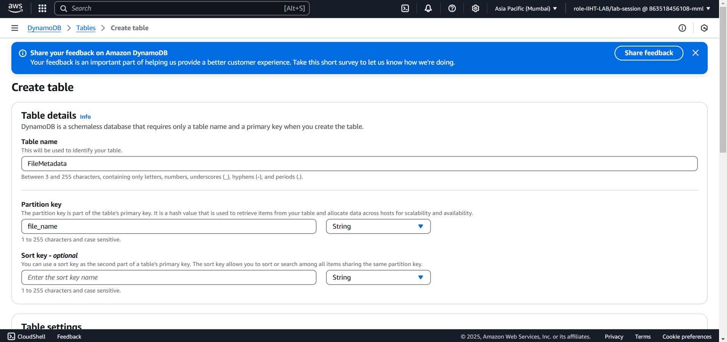
Create a dynamodb table

Slide 19
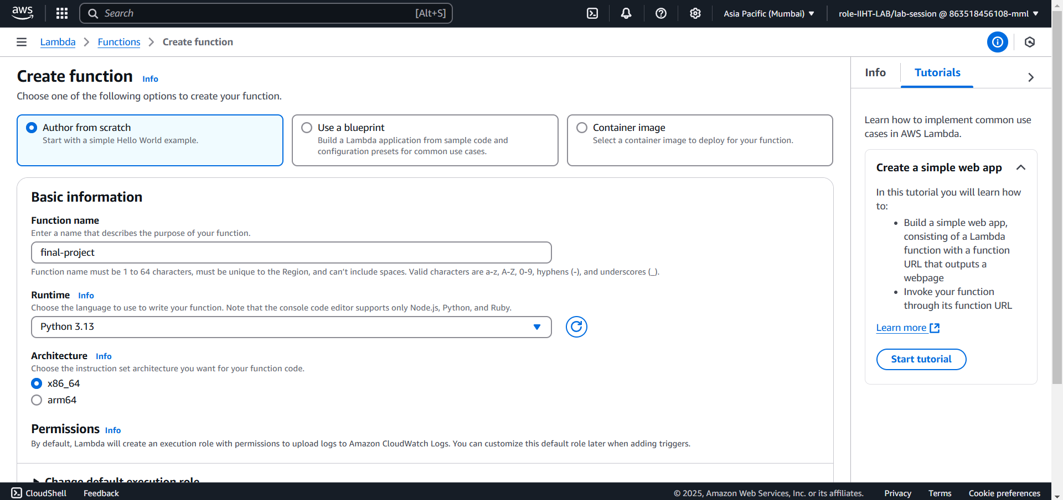
Create a lambda function

Slide 20
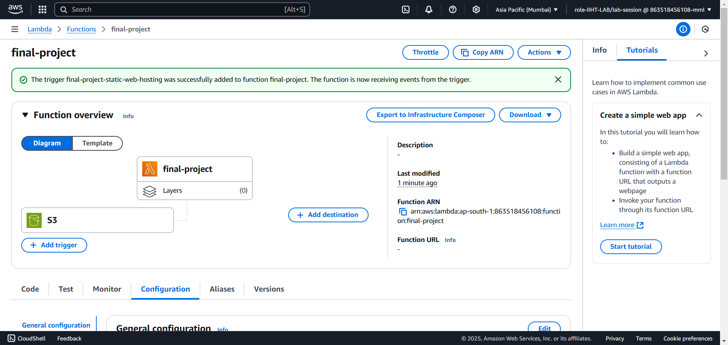
adding a trigger to lambda function

Slide 21
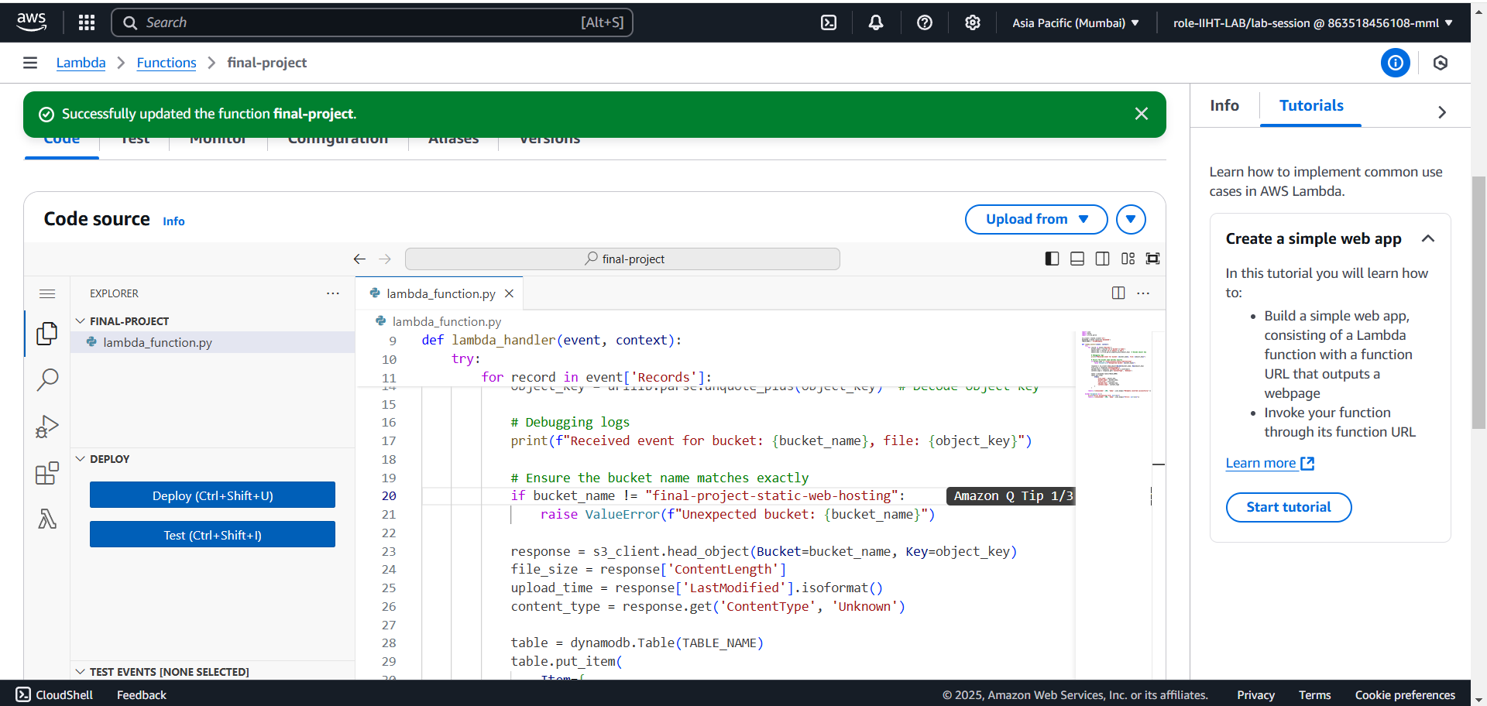
Source code to lambda function

Slide 22
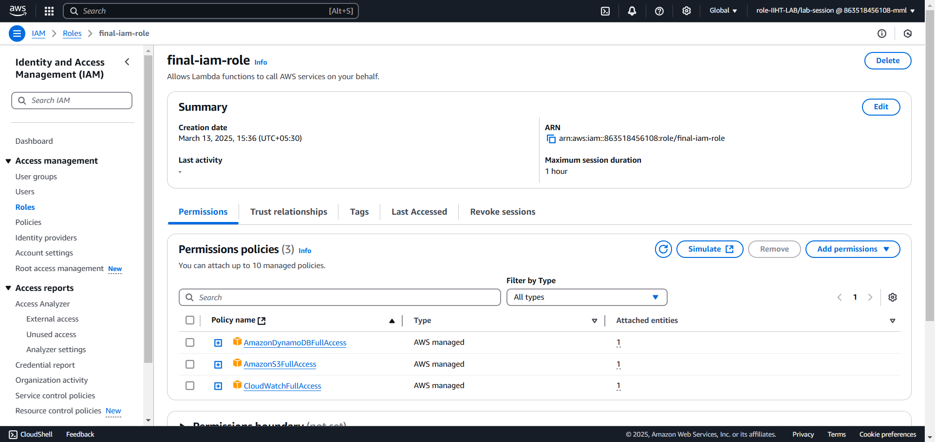
Iam role to lambda function

Slide 23
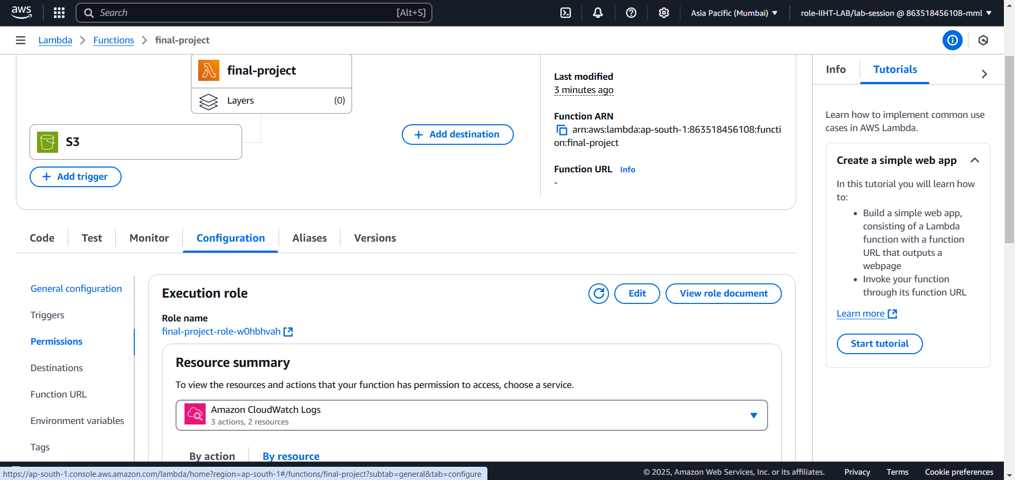
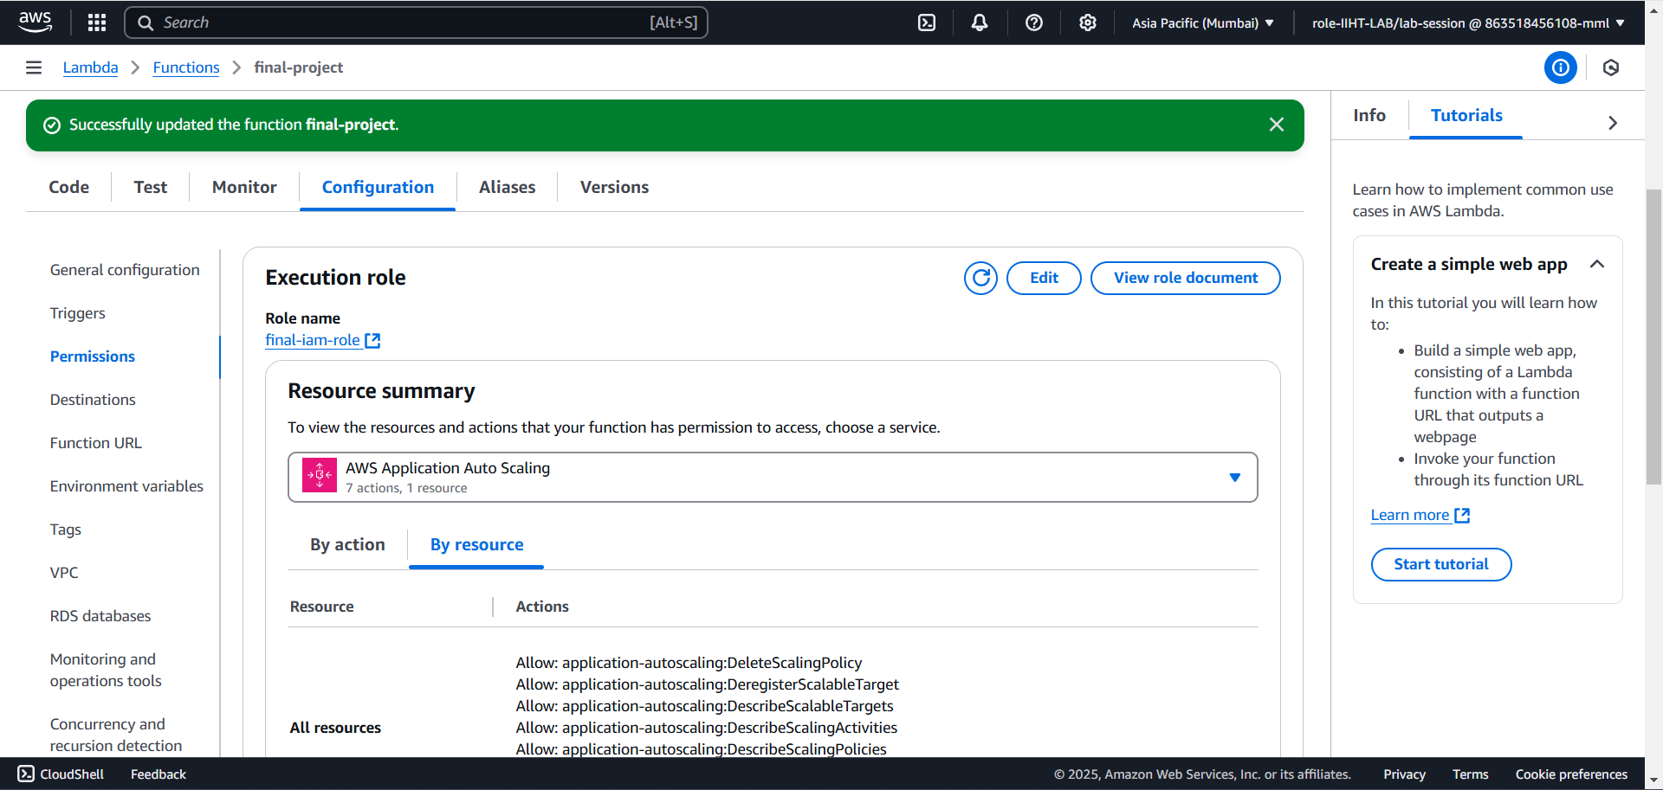
Attaching the Iam role

Slide 25
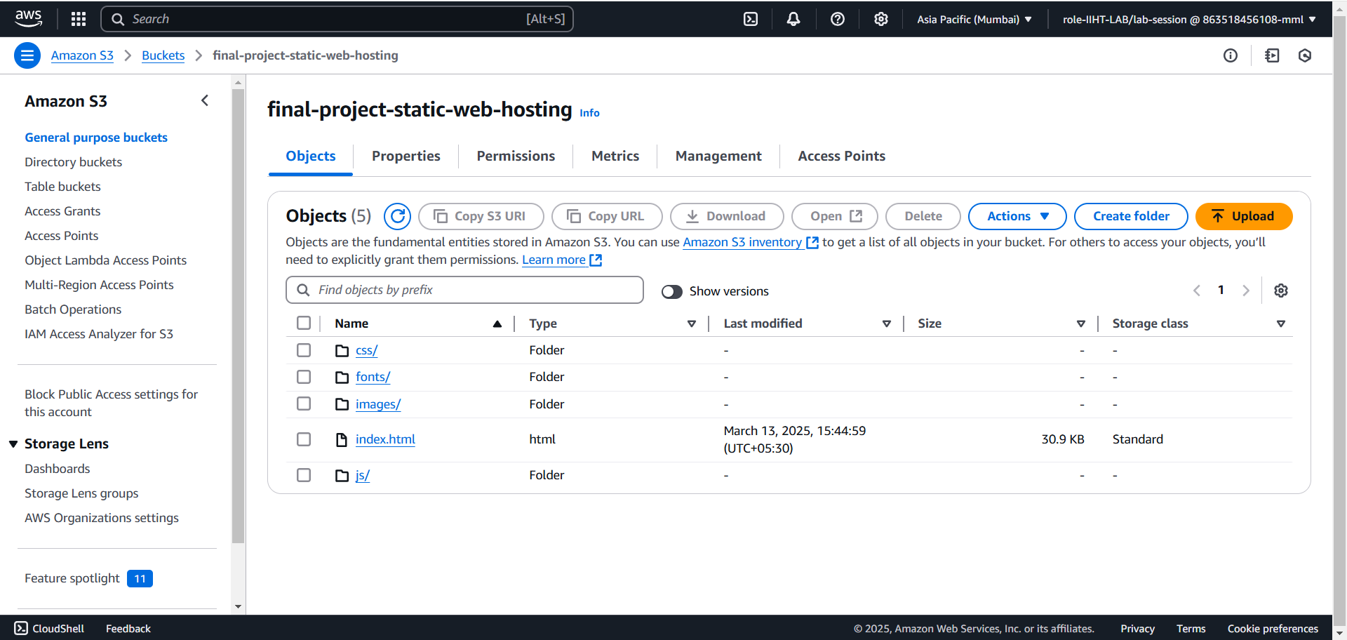
Adding web files to s3 bucket

Slide 26
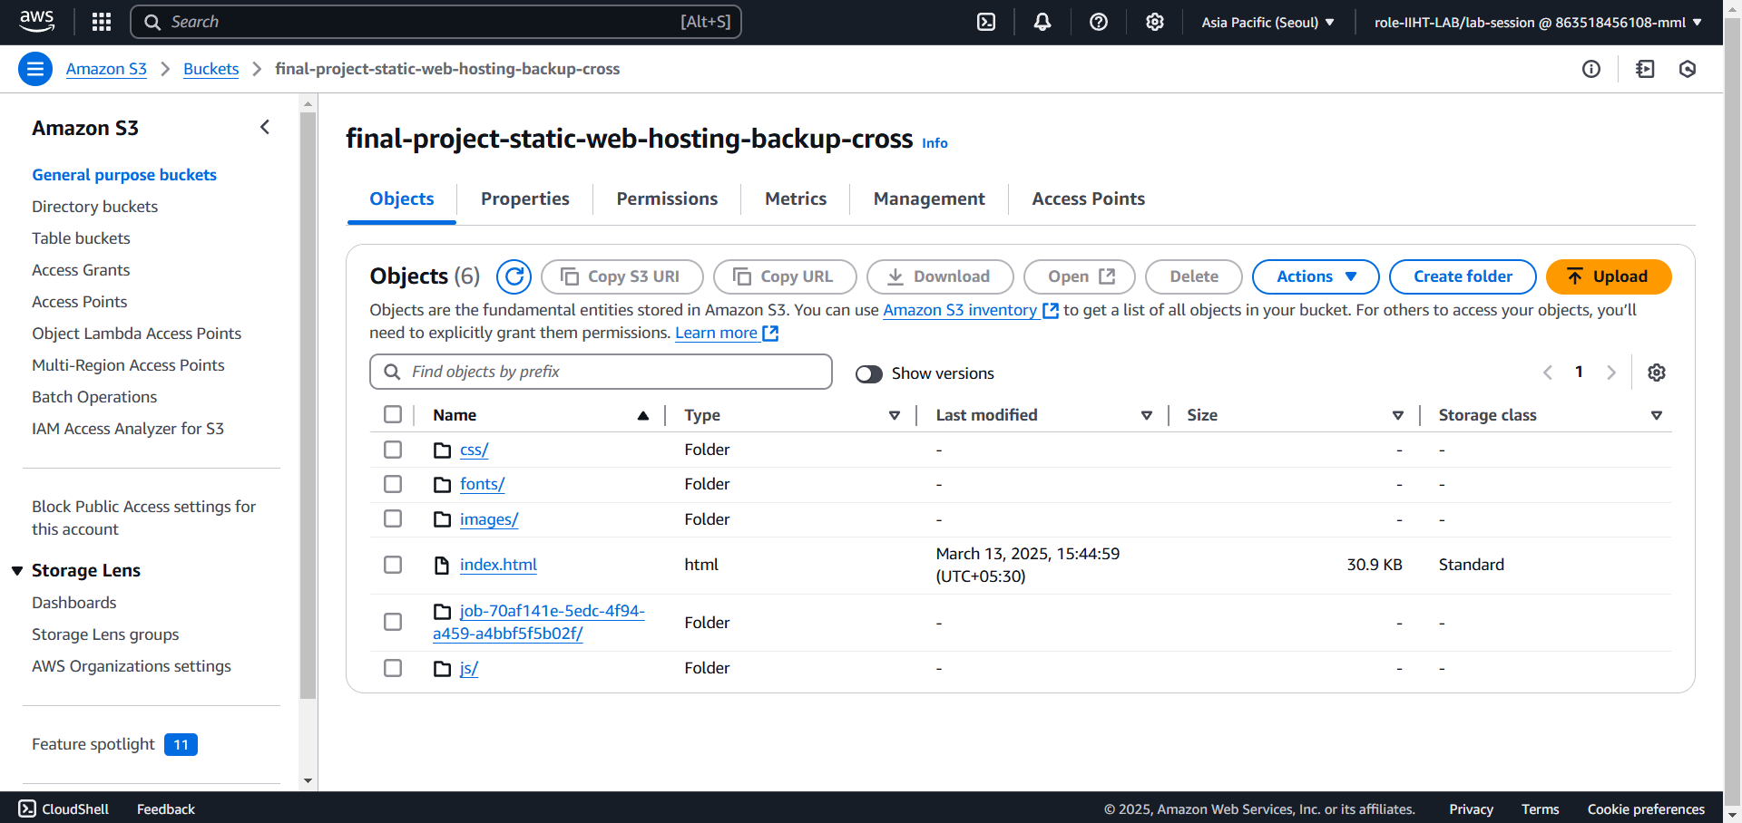
Verifying s3 bucket replication

Slide 27
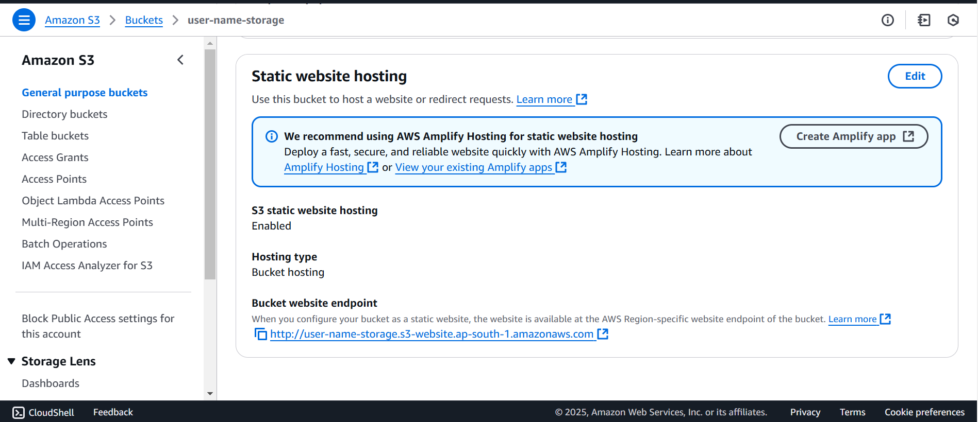
Enabling static web hosting

Slide 28
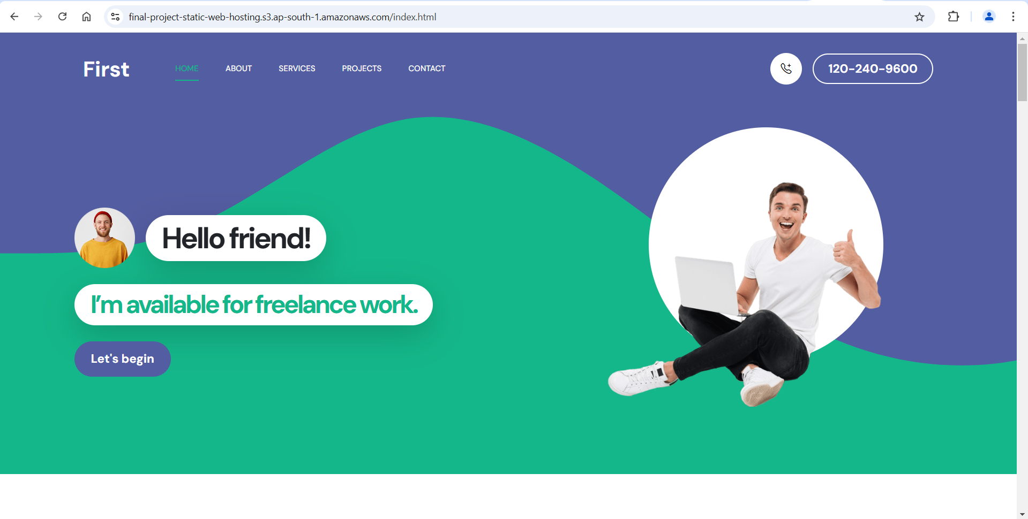
Hosting the website

Slide 29
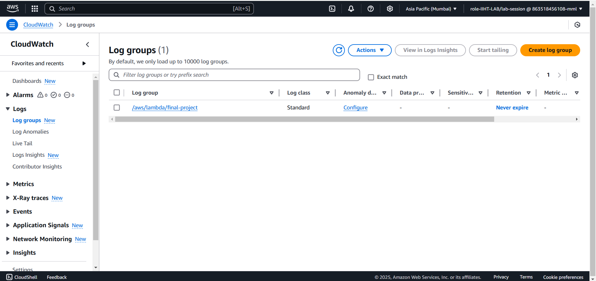
Cloudwatch log groups

Slide 30
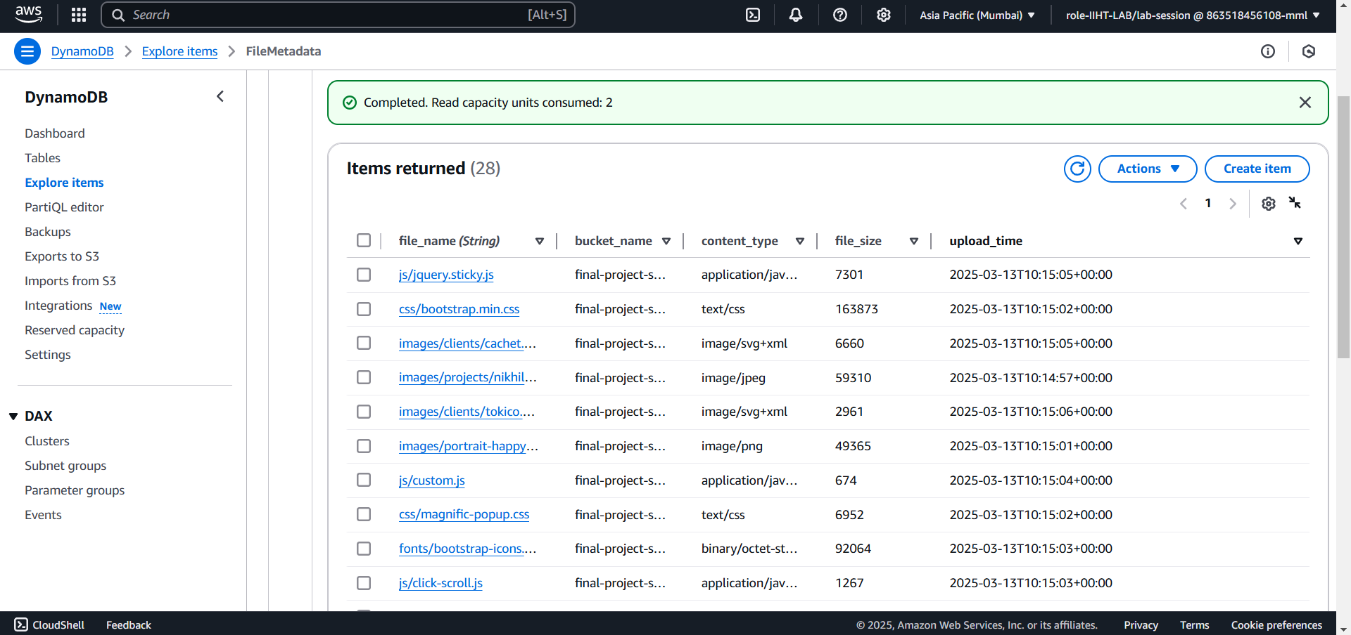
Verifying metadata in dynambodb

Slide 31
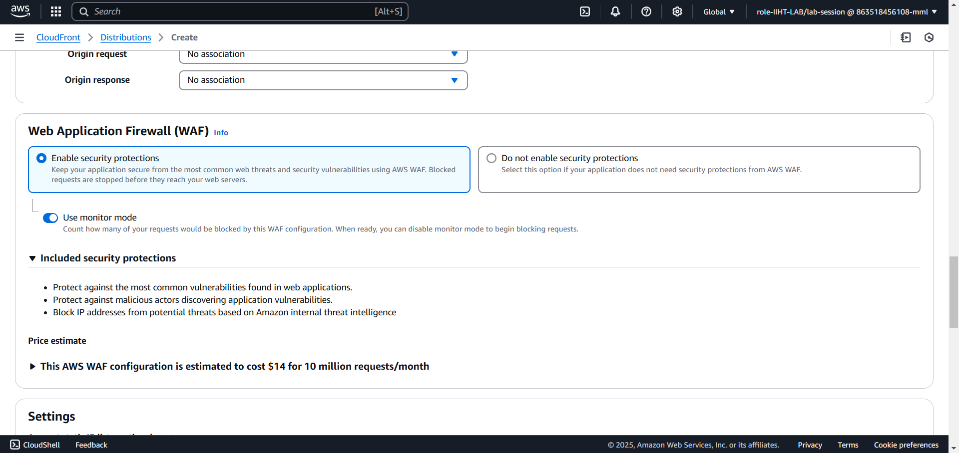
Creating a cloudfront distribution

Slide 32
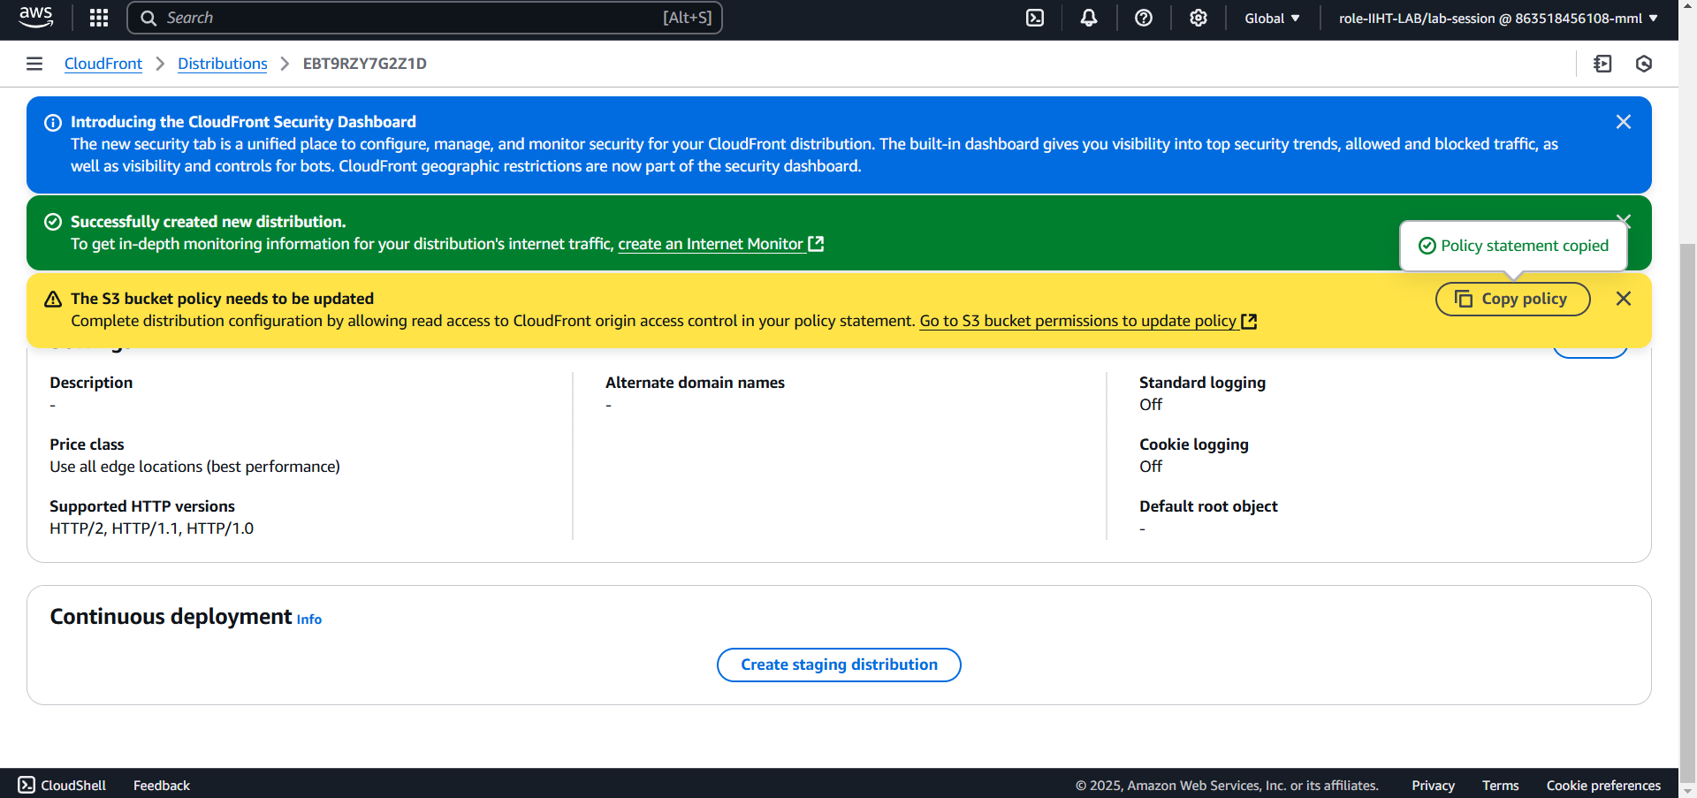
distribution policy for s3 bucket

Slide 33
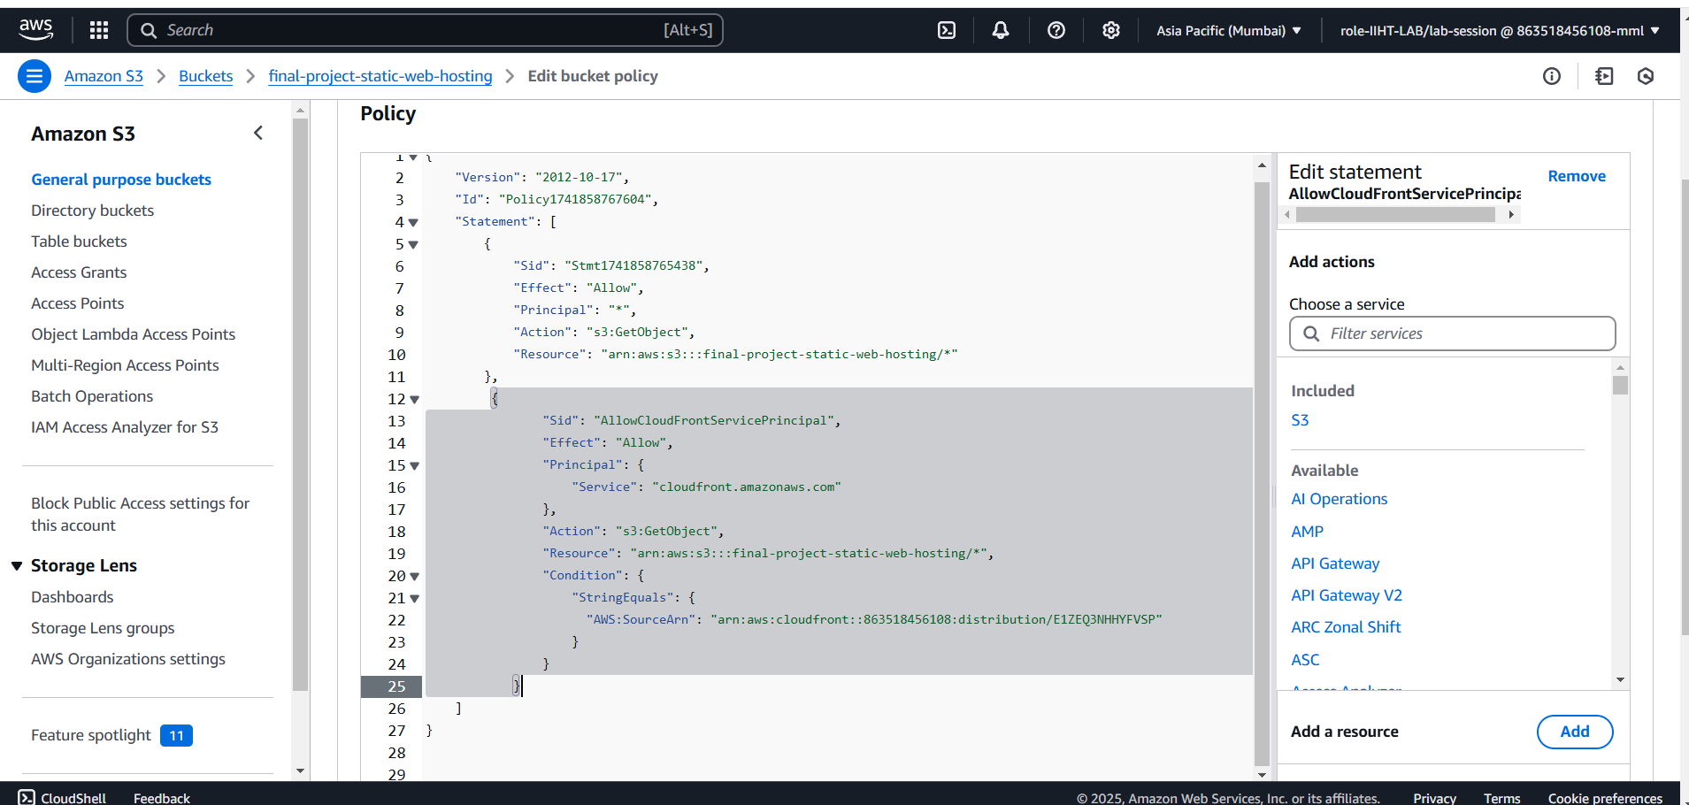
Updating s3 bucket policy

Slide 34
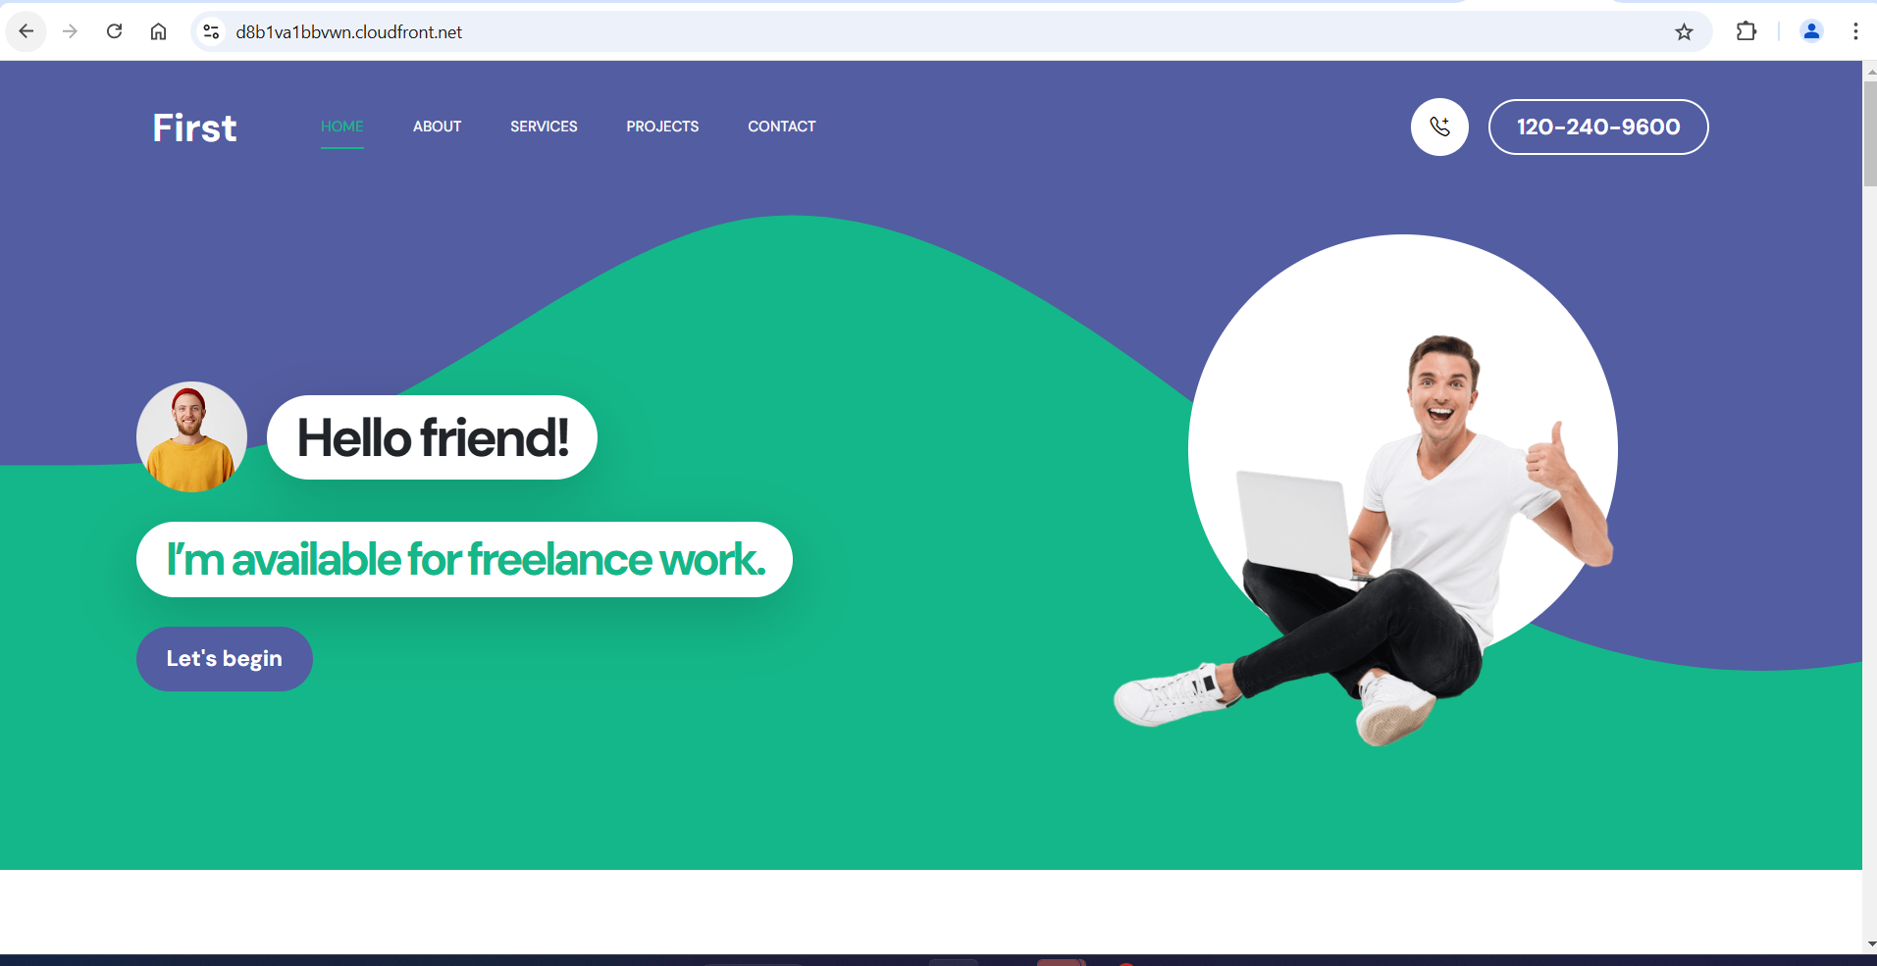
Hosting website with distribution domain name

Slide 35
THANK YOU

